Slide 1
Multi-Objective Optimization: Solution Algorithms
Genetic algorithms and MOO
Pareto-filtering and Niche techniques
CPE 778, Lect. 35

Slide 2
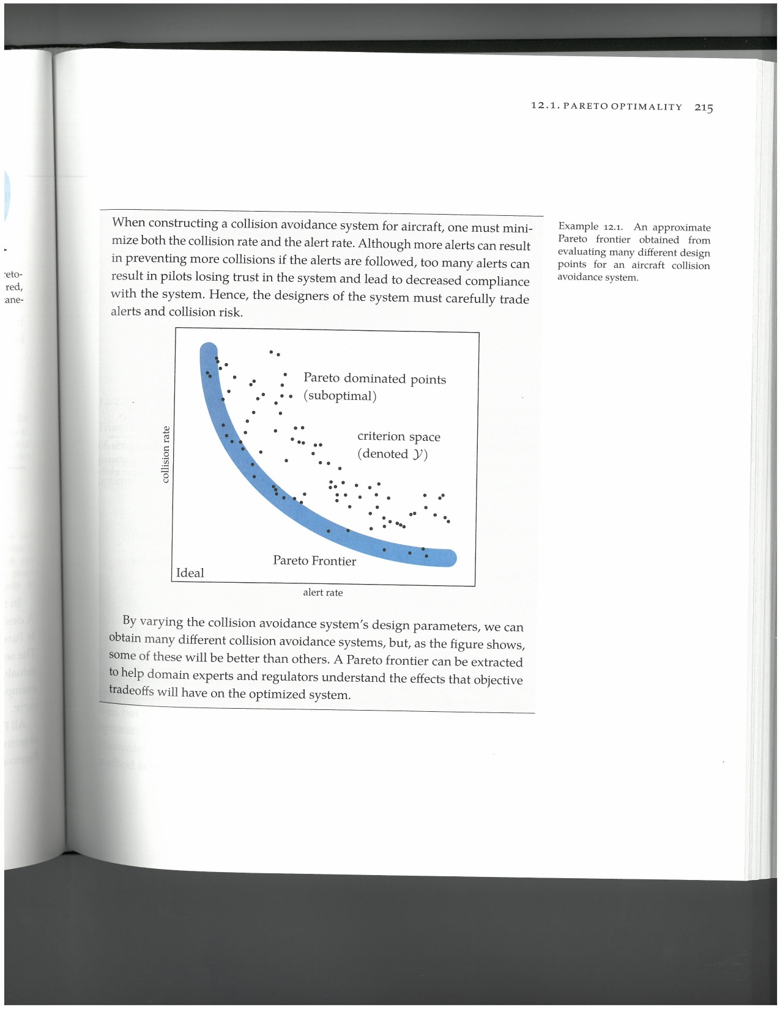
The Pareto-Frontier
Remember last time we were searching for feasible points within the Pareto-frontier:
A population method, such as a genetic algorithm, is particularly suited to this problem
CPE 778, Lect. 35

Slide 3
Why GA’s?
When we use a GA, we have a large population of feasible solutions. We can always compute which ones are dominated, and give them a low (but nonzero) fitness
Infeasible solutions are removed
We can tune the mutation rate to be higher for dominated solutions, or for the “extreme” solutions in which one objective is very poor
We also select partners for crossover non-randomly, to mix the best characteristics of non-dominated solutions
CPE 778, Lect. 35

Slide 4
The Pareto Filter
Another trick to find good multiobjective solutions with a GA is to save the best (non-dominated) solutions on a separate list, and then don’t let them reoccur in the next generation
If one solution on the list becomes dominated, remove it
This forces more diversity in the population, while always saving a set of solutions which evolves into the pareto-frontier
What algorithm does this remind you of?
It’s just like Tabu search…
CPE 778, Lect. 35

Slide 5
Avoiding Clustering
One issue we commonly see with GA’s for multi-objective optimization is clustering (or forming a “niche”
Many solutions lie near each other, and we don’t get a broad set of Pareto-optimal points.
One way to avoid this is to decrease the fitness of all non-dominated solutions which have too many solutions nearby
Another is to use an adaptive GA: change the mutation rate and crossover rate dynamically, based on clustering or other parameters, during the search
CPE 778, Lect. 35

Slide 6
Conclusions
Multiobjective optimization allows us to properly handle cases in which trade-offs between competing objectives are unclear.
We often use genetic algorithms to compute a Pareto-frontier, with some modifications
Using a Pareto-filter allows the storage of potential Pareto-optimal points, and guides the search
Niche techniques avoid clustering of solutions in small areas of the search space.
CPE 778, Lect. 35

